Slide 1

Project Proposal
One Stop for trekking solution
Kamal Tamrakar
HOD/CO-ORDINATOR
BCA 4 th Semester
Laxmi Thami (6-2-263-16-2021)
Siddhartha Shakya(6-2-263-29-2021)

Slide 2
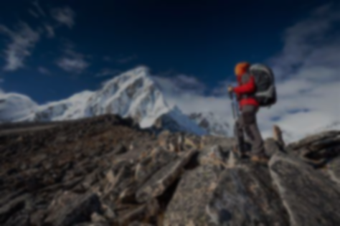
Introduction
Development of a unique e-commerce website targeting Nepal's trekking market.
Leveraging Nepal's trekking landscape and cultural heritage.
Offering a one-stop destination for adventurous travelers.
Providing curated selection of trekking gear, personalized recommendations, and local expertise.
Utilizing CRUD for achieving necessary functionality.

Slide 3
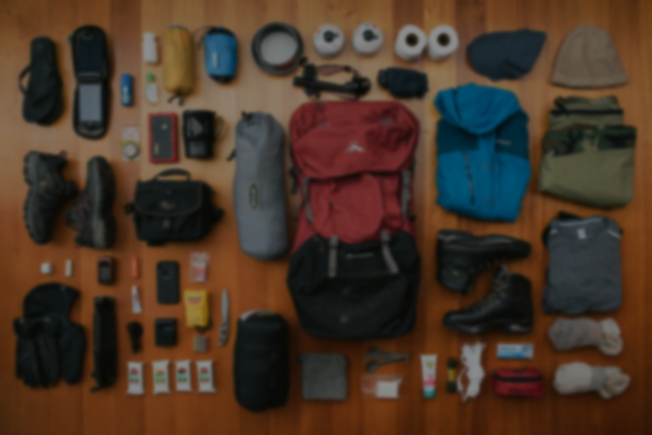
Problem Statement
Existing platforms lack specialization in Nepal's trekking market.
Limited availability of reliable information on trekking routes and local experiences.
Challenges in accessing suitable gear tailored to Nepal's diverse terrains and weather conditions.
Lack of platforms that effectively capture the essence of Nepal's distinct trekking culture.

Slide 4
Objectives
Develop a specialized e-commerce platform tailored to Nepal's trekking market.
Offer a wide selection of trekking gear suitable for Nepal's diverse terrains and weather conditions.
Capture the essence of Nepal's distinct trekking culture through the platform's design and content.

Slide 5
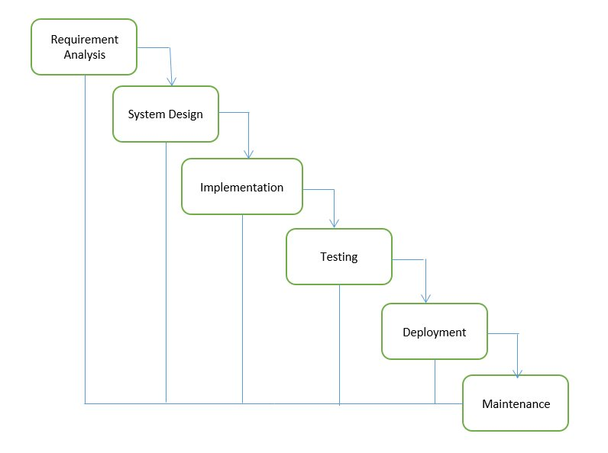
Methodology
Waterfall model

Slide 6
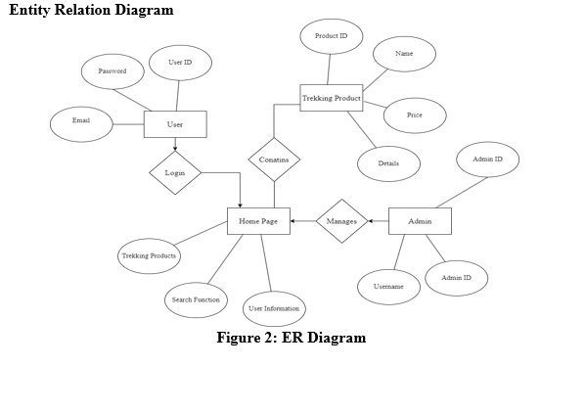

Slide 7
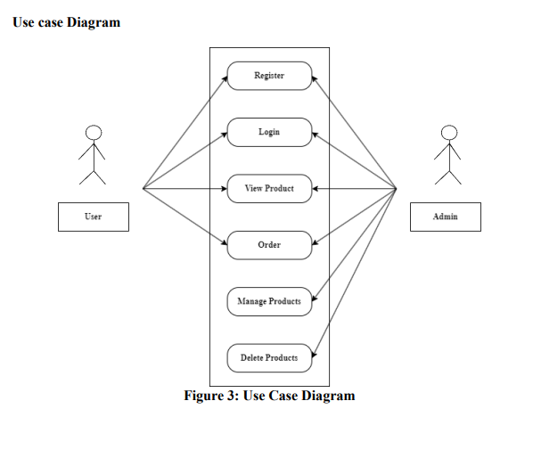
Use case diagram

Slide 8
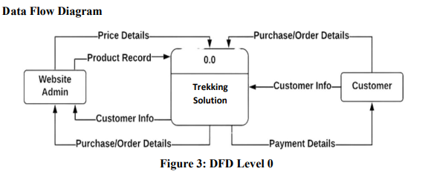
Data flow diagram

Slide 9
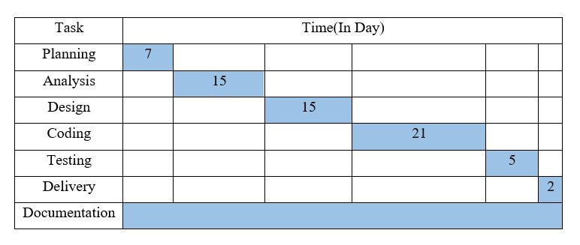
Gantt chart

Slide 10
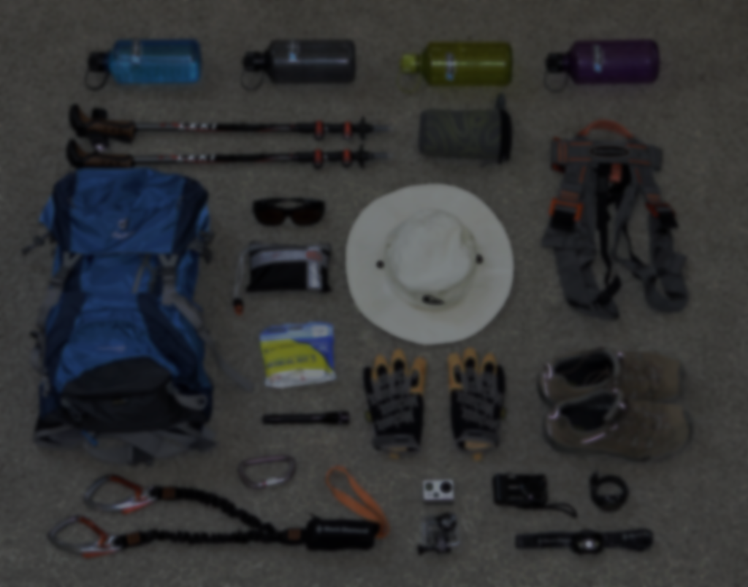
Expected Outcome
Cultural and Local Engagement
Community Involvement
Participation in Tourism Promotion

Slide 11
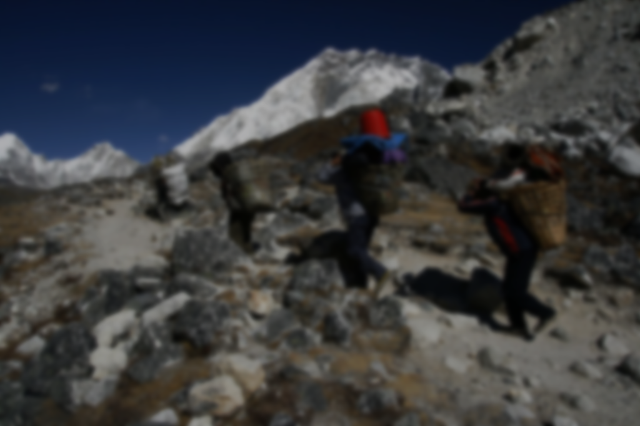
Limitation
Dependency on third-party suppliers and logistics may lead to delays.
Security vulnerabilities in online transactions.
Competition from established offline and online retailers.

Slide 12


Slide 13
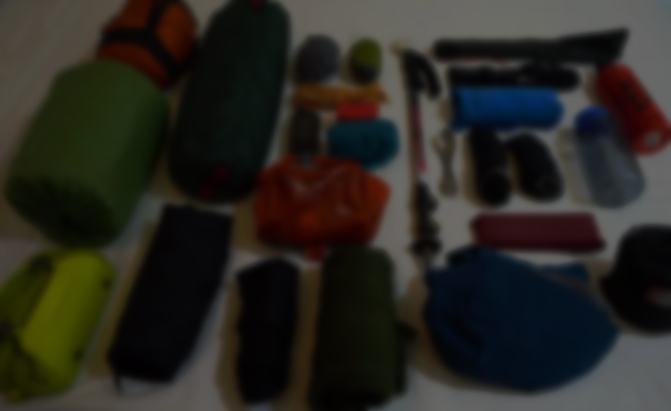
Thank You

